Slide 1

Recommend Calculator
Project by Van Luong

Slide 2
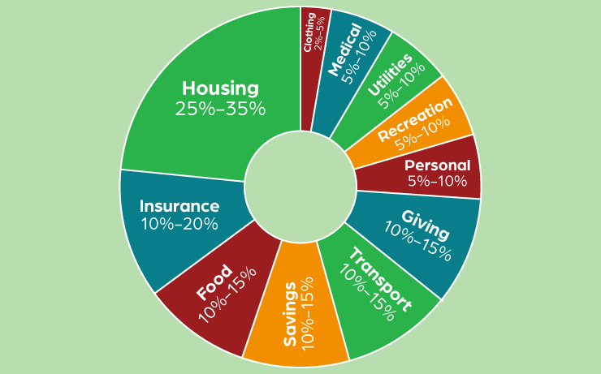
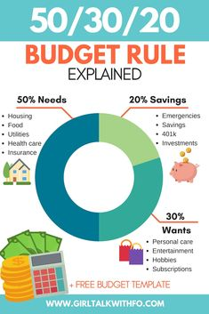




Tag Line
“Professional budgeting made easy for you!”

Slide 3
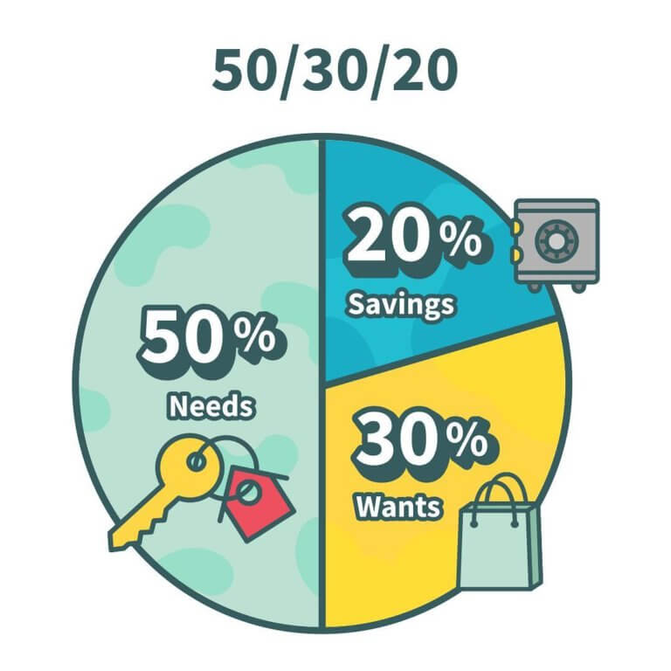
Chime Recommended Budget
Percentage-based budget
divides up your earnings into percentages that go toward your expenses, savings, debt, and other categories
One of the most common percentage-based budgets is 50/30/20 Rule
50% Needs
30% Wants
20% Savings
Based on that rule, we will divide that farther
Used this website for idea of project
https://www.chime.com/blog/recommended-budget-category-percentages/#:~:text=Start%20with%20the%20Basics,Here's%20how%20this%20would%20look.

Slide 4
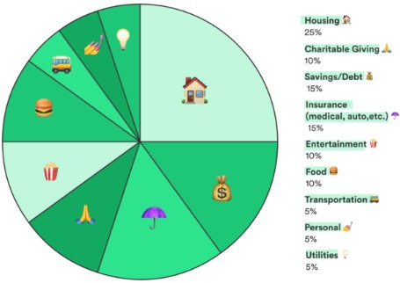
Basic Recommended Budget Category Percentages from Chime
We used this break down of each category in the project
Standard budget percentages if you want to have enough money for your needs and wants
We will program the calculations for each percentages listed
After finding percentages, will be easier to allocate expenses

Slide 5

Python Project Planning
Want an insert income option for input
Automatically calculates each of the Basic Recommended Budget Category Percentages from Chime
Needs to be in money for format
Needs to round to the nearest cent
Option to quit and exit program
Have a select menu

Slide 6
Program Flowchart

Slide 7
Related Python Code
Used some code from Katie Musso Budgeting project on KSU Github
https://github.com/ksu-is/Budgeting
Had same idea and needs for code
Need make own calculation
Need to remove and add functions
Like the quit and introduction messages

Slide 8
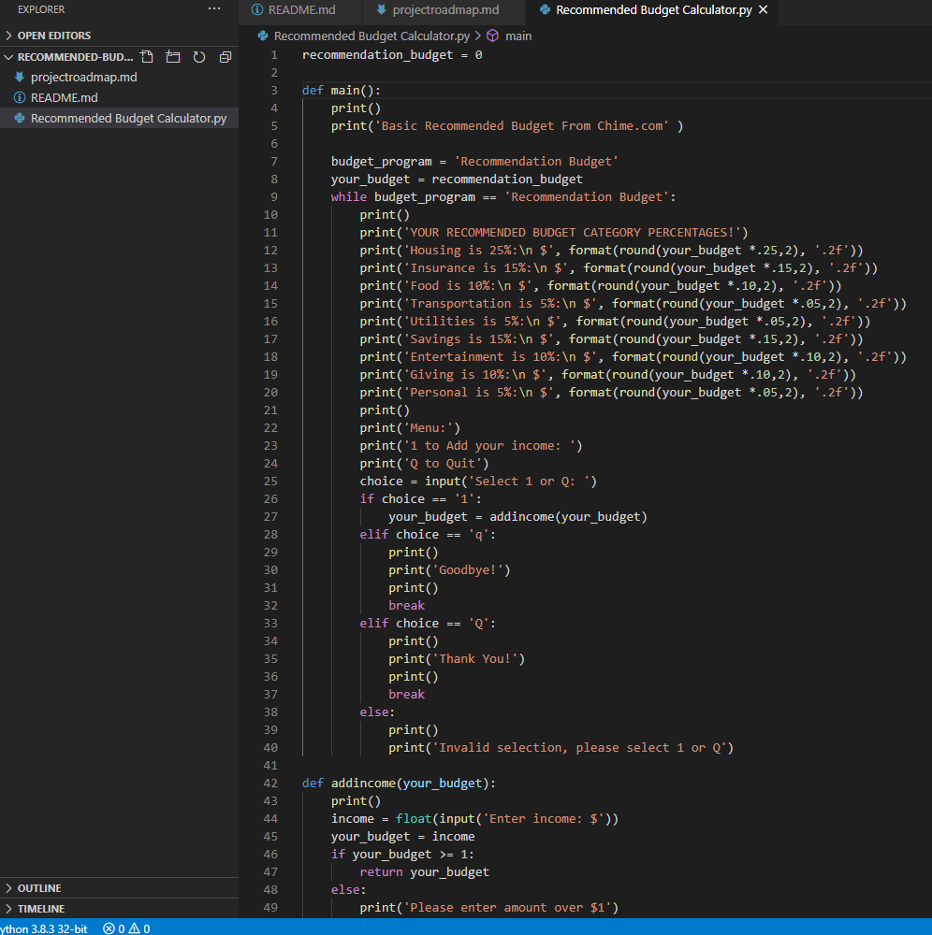
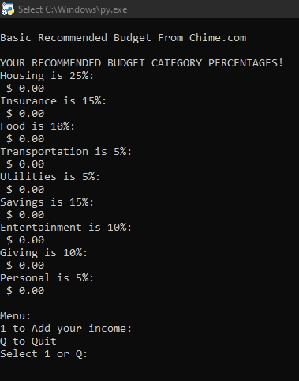
My Program Screenshots

Slide 9
Sources
https://www.chime.com/blog/recommended-budget-category-percentages/#:~:text=Start%20with%20the%20Basics,Here's%20how%20this%20would%20look.
https://www.chime.com/blog/the-ultimate-guide-to-the-503020-budget/
https://github.com/ksu-is/Budgeting
https://github.com/ksu-is/Recommended-Budget-Calculator

